Slide 1
UVic Course Registration System
Zhanchi Guan, Aaron Yin,
Rui Sun, Junhong Deng

Slide 2
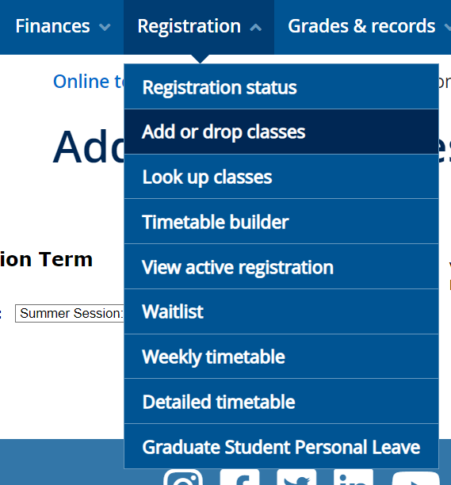
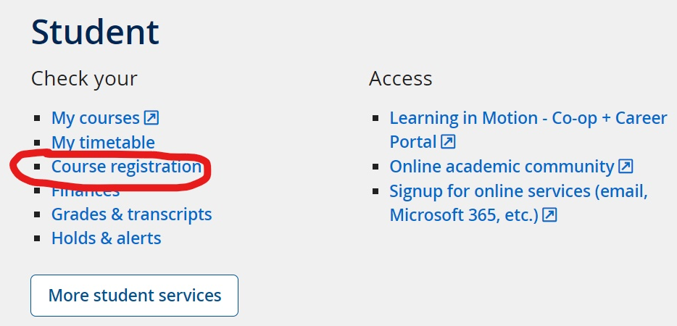

Slide 3
Participants
-5 UVic students
-different year standing

Slide 4
Interviews
-features you like/dislike
-first time using the CRS
-how to plan a semester

Slide 5
Interview Results
Categorization of subject
lack of information and visible timetable
negative first time experience
multiple tabs

Slide 6
Questions

Slide 7
Thank you

